Slide 1


DS501 Statistical and Mathematical methods for Data Science
Lecture Week 07
Distribution & Hypothesis
Certified Data Analyst [KARACHI.AI]

Slide 2
Data and Sampling Distributions
A popular misconception holds that the era of big data means the end of a need for sampling.
In fact, the analysis of data of varying quality and relevance reinforces the need for sampling as a tool to work efficiently with a variety of data and to minimize bias.
In figure, the left-hand side represents a population that, in statistics, is assumed to follow a defined but unknown distribution.
The only thing available is the sample data and its empirical distribution, shown on the right-hand side.
To get from the left-hand side to the right-hand side, a sampling procedure is used (represented by dashed arrows)

Slide 3
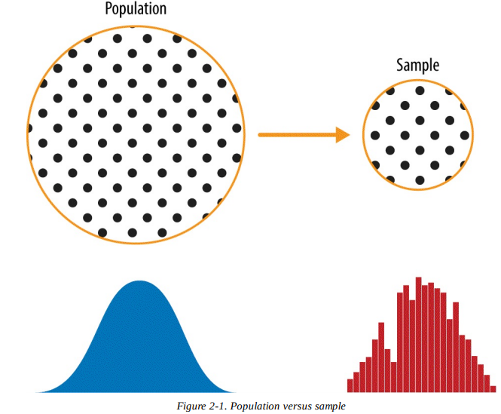
Data and Sampling Distributions
In general, data scientists need not worry about the theoretical nature of the left-hand side, and instead should focus on the sampling procedures and the data at hand.

Slide 4
Random Sampling and Sample Bias
A sample is a subset of data from a larger data set;
statisticians call this larger data set the population.
A population in statistics is not the same thing as in biology — it is a large, defined but sometimes theoretical or imaginary, set of data.
Another example is color contrast in colored image is not only pure RGB patterns but it might be a combination of RGB (0 – 255) contrast are possible in a 8-bit system.

Slide 5
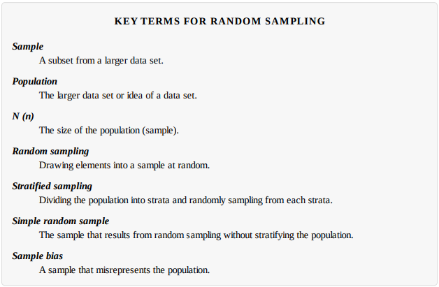
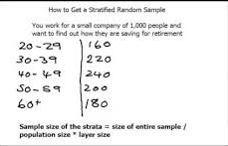
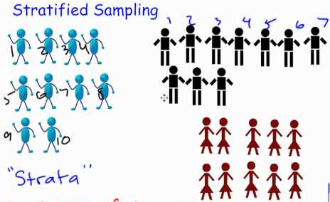
Data and Sampling Distributions

Slide 6
Data and Sampling Distributions
Bias
Statistical bias refers to measurement or sampling errors that are systematic and produced by the measurement or sampling process.
An important distinction should be made between errors due to random chance, and errors due to bias.
Consider the physical process of a gun shooting at a target.
It will not hit the absolute center of the target every time, or even much at all.
An unbiased process will produce error, but it is random and does not tend strongly in any direction (see Figure 7-1). The results shown in Figure 7-2 show a biased process — there is still random error in both the x and y direction, but there is also a bias. Shots tend to fall in the upper-right quadrant.

Slide 7
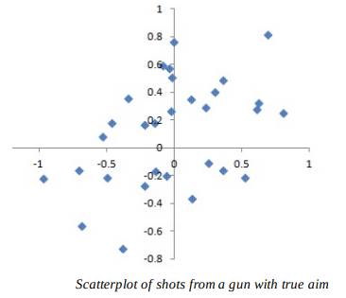
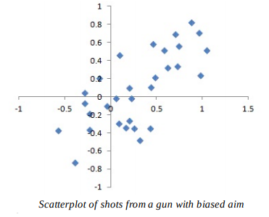
Data and Sampling Distributions

Slide 8
Data and Sampling Distributions
Random Selection
To avoid the problems of sample bias there are now a variety of methods, but at the heart of all of them lies random sampling.
Sampling Distribution of a Statistic
The term sampling distribution of a statistic refers to the distribution of some sample statistic, drawn from the same population.
Much of classical statistics is concerned with making inferences from (small) samples to (very large) populations.

Slide 9
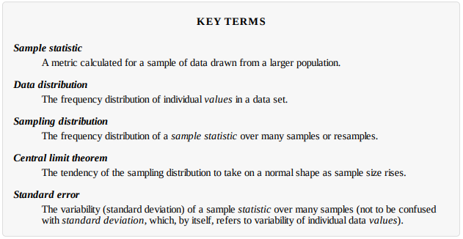
Data and Sampling Distributions

Slide 10
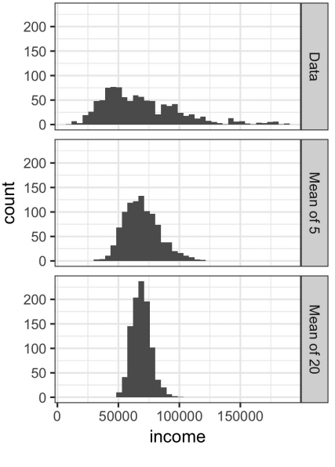
Data and Sampling Distributions
The distribution of a sample statistic such as the mean is likely to be more regular and bell-shaped than the distribution of the data itself. The larger the sample that the statistic is based on, the more this is true. Also, the larger the sample, the narrower the distribution of the sample statistic.
Example: Take three samples data:
a sample of 1,000 values, a sample of 1,000 means of 5 values, and a sample of 1,000 means of 20 values. Then plot a histogram of each sample to produce Figure.

Slide 11
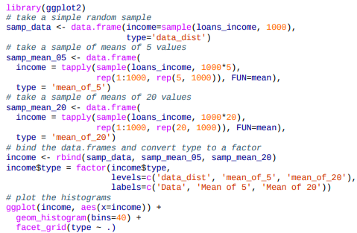
Data and Sampling Distributions

Slide 12
Data and Sampling Distributions
Central Limit Theorem
The termed central limit theorem says that the means drawn from multiple samples will resemble the familiar bell-shaped normal curve, even if the source population is not normally distributed.
The central limit theorem allows normal-approximation formulas like the t-distribution to be used in calculating sampling distributions for inference — that is, confidence intervals and hypothesis tests.
The central limit theorem forms the foundation for the inferential branch of statistics.
This theorem describes the relationship between the sampling distribution of sample mean and the population.

Slide 13
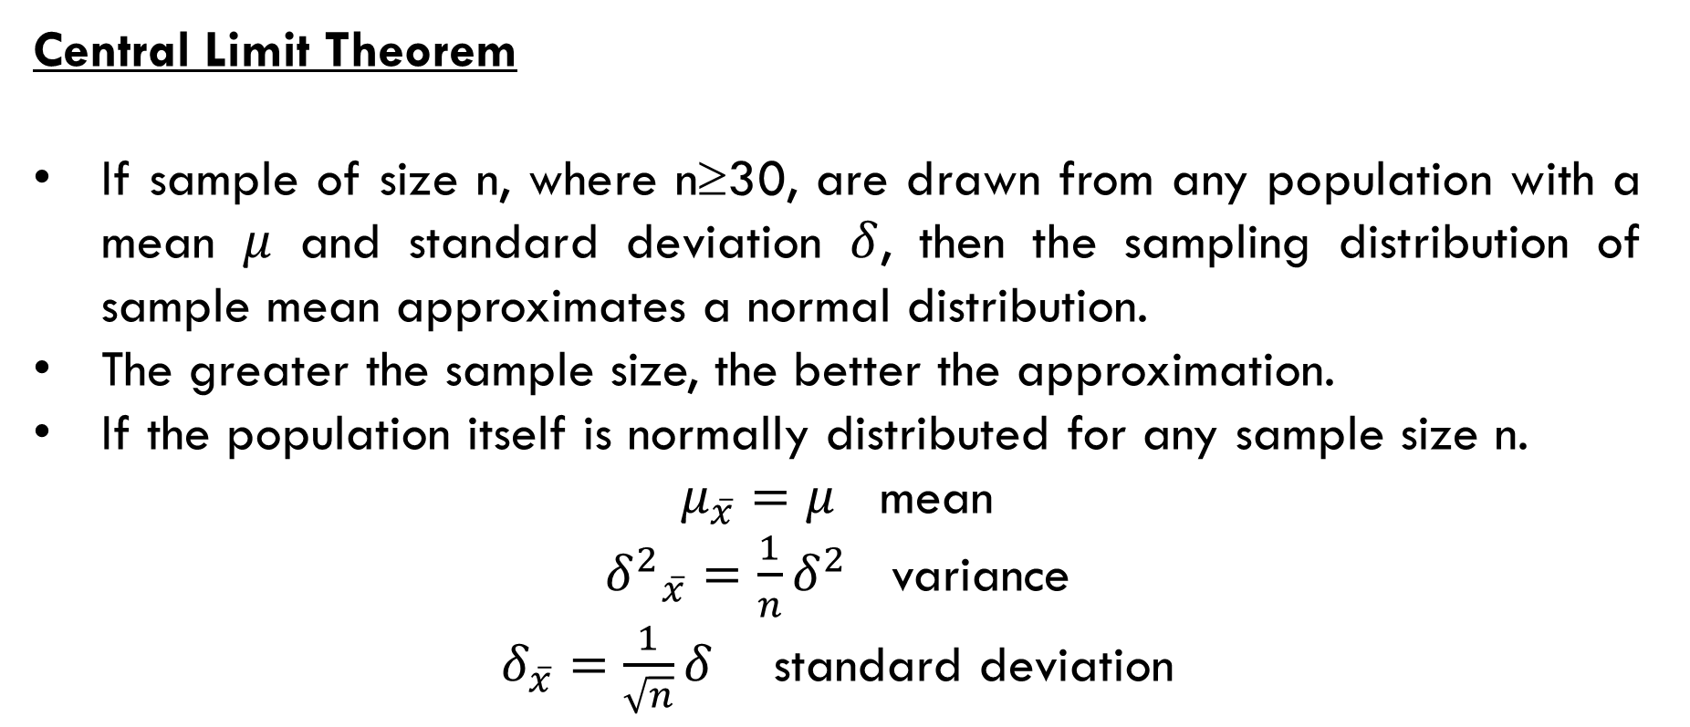
Data and Sampling Distributions
Central Limit Theorem
If sample of size n, where n≥30, are drawn from any population with a mean $μ$ and standard deviation $δ$, then the sampling distribution of sample mean approximates a normal distribution.
The greater the sample size, the better the approximation.
If the population itself is normally distributed for any sample size n.
$μ_{\overline{x}}=μ$ mean
${δ^{2}}_{\overline{x}}=\frac{1}{n}δ^{2}$ variance
$δ_{\overline{x}}=\frac{1}{\sqrt{n}}δ$ standard deviation

Slide 14

Data and Sampling Distributions
Standard Error:
The standard error is a single metric that sums up the variability in the sampling distribution for a statistic.
The standard error can be estimated using a statistic based on the standard deviation s of the sample values, and the sample size n:
In modern statistics, the bootstrap has become the standard way to estimate standard error.

Slide 15
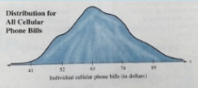
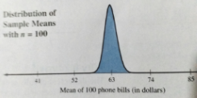
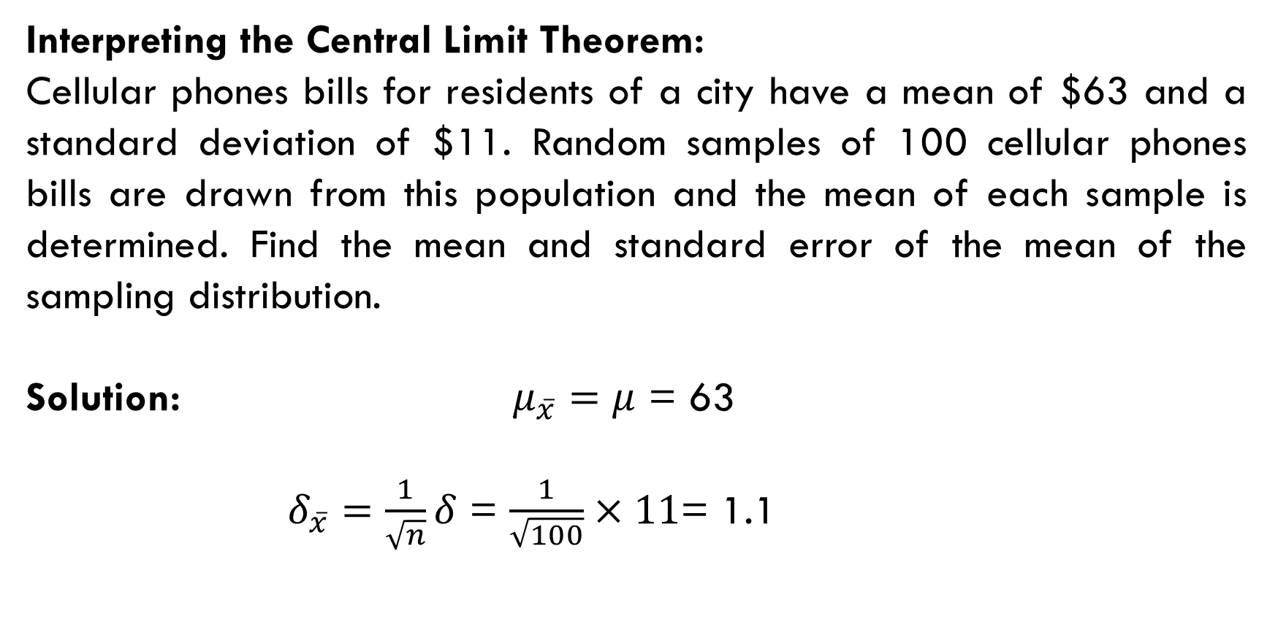
Data and Sampling Distributions
Interpreting the Central Limit Theorem:
Cellular phones bills for residents of a city have a mean of $63 and a standard deviation of $11. Random samples of 100 cellular phones bills are drawn from this population and the mean of each sample is determined. Find the mean and standard error of the mean of the sampling distribution.
Solution: $μ_{\overline{x}}=μ$ = 63
$δ_{\overline{x}}=\frac{1}{\sqrt{n}}δ$ = $\frac{1}{\sqrt{100}}×11$= 1.1

Slide 16
distributions
Assuming the normal heart rate (H.R) in normal healthy individuals is normally distributed with Mean = 70 and Standard Deviation =10 beats/min.
1) What area under the curve is above 80 beats/min?
2) What area of the curve is above 90 beats/min?
3) What area of the curve is between
50-90 beats/min?
4) What area of the curve is above 100 beats/min?
5) What area of the curve is below 40 beats per min or above 100 beats per min?

Slide 17
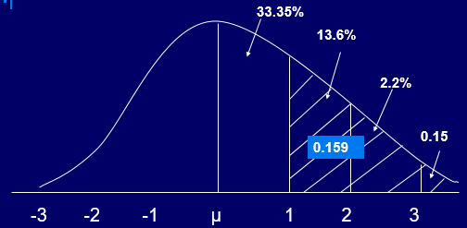
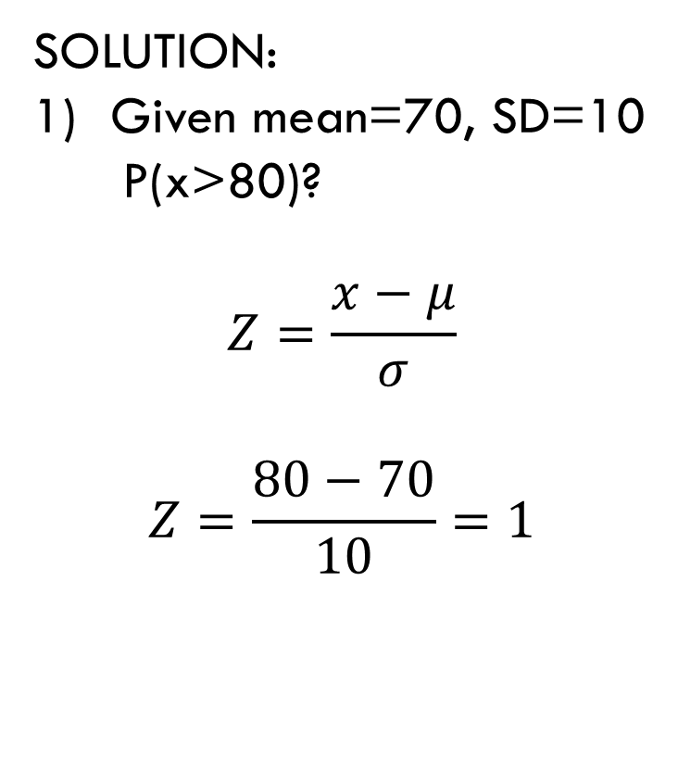
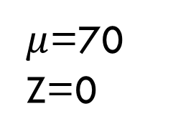
distributions
SOLUTION:
Given mean=70, SD=10
P(x>80)?
$$Z=\frac{x−μ}{σ}$$
$$Z=\frac{80−70}{10}=1$$
0.5
0.3413
$μ$=70
Z=0
x=80
Z=1

Slide 18
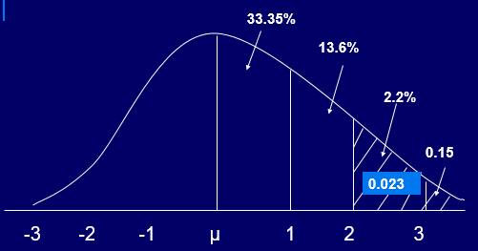
distributions
SOLUTION 2:

Slide 19
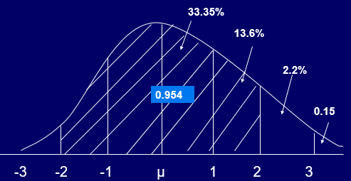
distributions
SOLUTION 3:

Slide 20
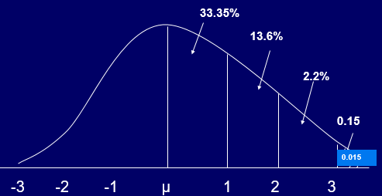
distributions
SOLUTION 4:

Slide 21
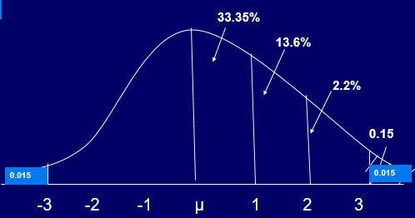
distributions
SOLUTION 5:

